Slide 1

Momo Medical
Salah Abdulkader, Theo van den Berg, Roy Duivenvoorden, Nick Keereweer, Floris van Lingen, Jeanine Nagy
Notes:
First of all: Welcome to the weekly presentation of the Momo Medical project

Slide 2
Table of contents
The project
What did we do?
Planning and managing the project
What are we going to do?
Notes:
Here you can see what the content is of our presentation. First we are going to refresh your memory of what this project is about. After that I m going to tell you what we did last week. Then I will tell some about how we go about planning and managing the project. Lastly I will give insight in what we are going to do next.

Slide 3
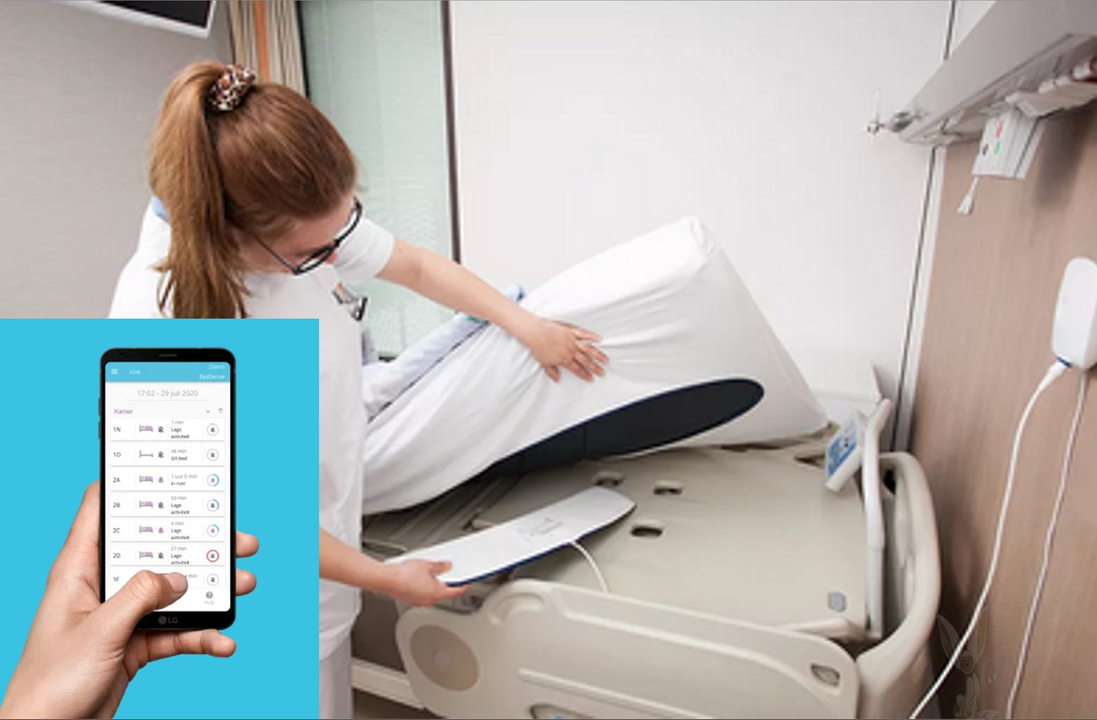
The project
Momo Medical is a start-up located in Delft
BedSense
Multiple sensors are located underneath the mattress
Goal 1 : Have less false positives
Goal 2: Predict when a patient is getting out of bed
Notes:
BedSense is an application which uses the data from multiple sensors, with the application employees are able to see the current status of their patients. If they are sleeping, if they are sitting on their bed or if they left their bed. These sensors are able to measure pressure and an algorithm is able to determine in what state the patient’s bed is.

Slide 4
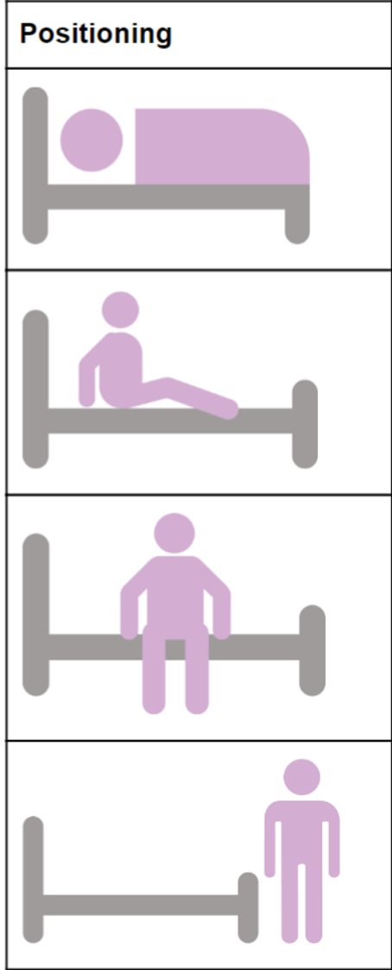
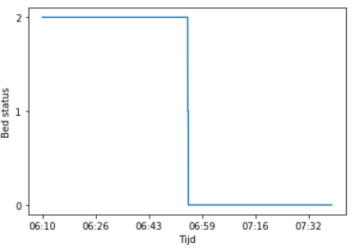
What did we do?
* Microsoft Teams meeting with Momo Medical
* Meetings with teachers
* Literature study
* Datacamp
* Made a global planning
* Updated the project Trello board
* Finished the research proposal
* Continued with data visualization
2
2
1
0
Notes:
So last week we did the weekly teams meeting with the product owner. We discussed our planning as well as the contents of our research proposal. Mostly the sample and population of our research and how we needed to validate our research. We also sent him the document so he could approve of the contents and give us some feedback.
We also did some literature research and have found some peer reviewed articles closely related to our project.
Of course we also did some more datacamp.
We have made a global planning as well. So we can estimated how much time we have left per step and so we can focus on getting some results next.

Slide 5
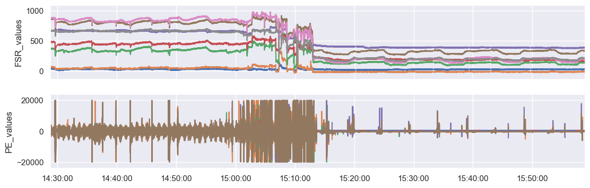
Data visualization
Notes:
The last few days some of our project members got to work on visualizing the data. Here you can see a subset of the data we have made we are trying to store less data and only save 30minutes before and after the event of changing bed status. As you can see in the bottom graph some colors are very present so in the future we are going to make a graph per value/color.

Slide 6
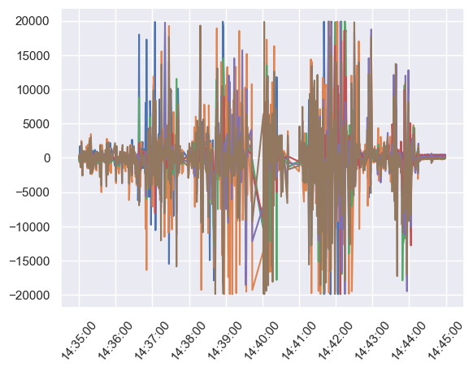
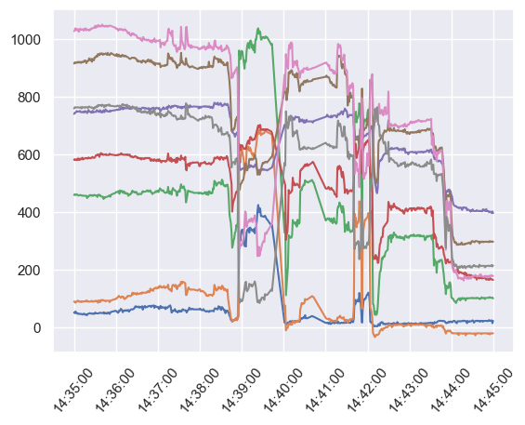
Data visualization

Slide 7
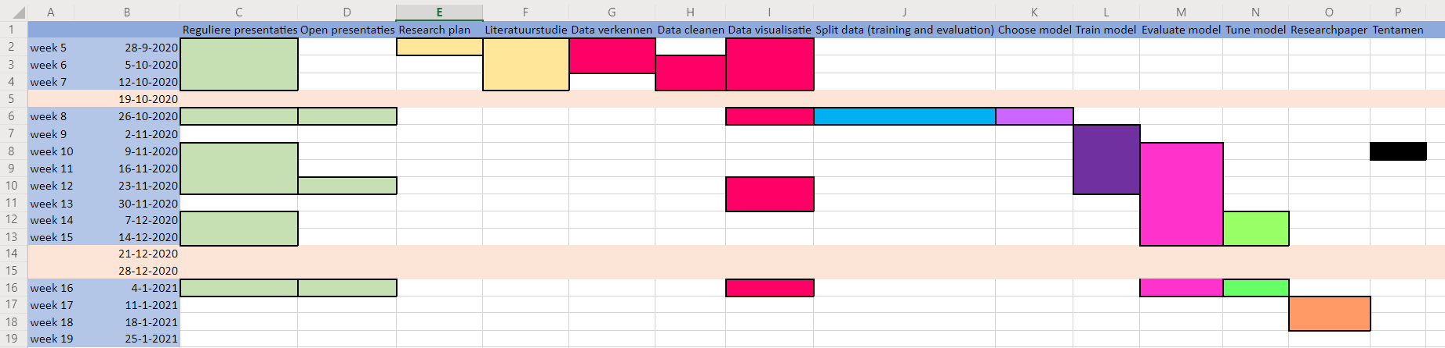
Planning and managing the project

Slide 8




Planning and managing the project
* Some processes will be performed iteratively
Tune model
Evaluate model
Choose model
Train model

Slide 9
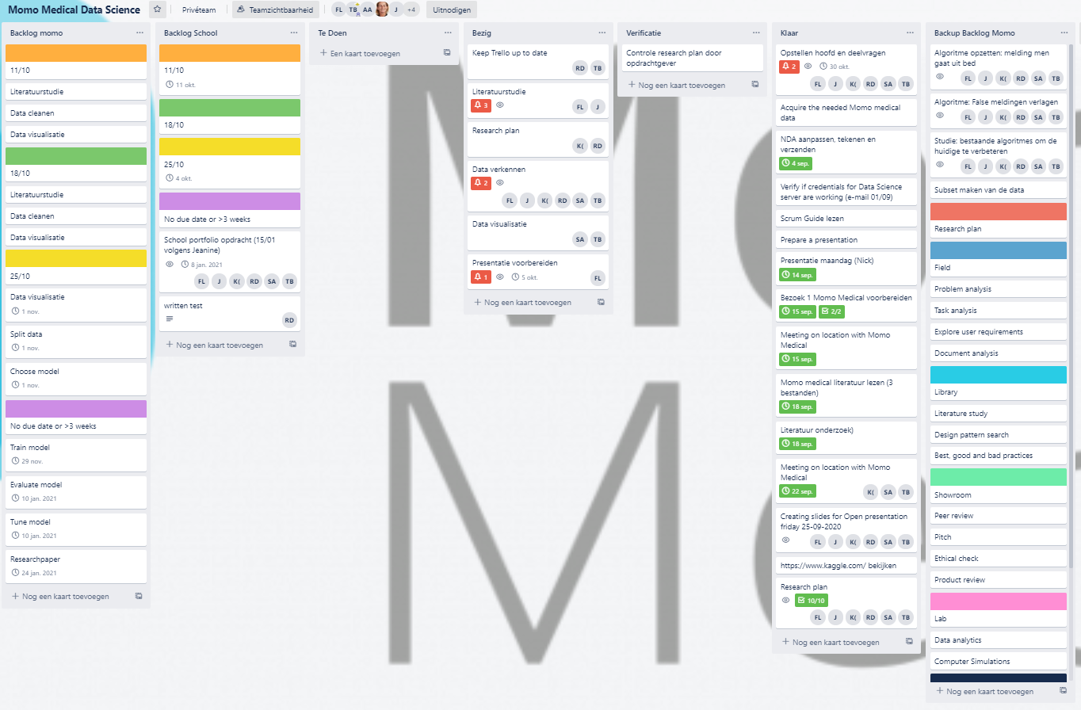
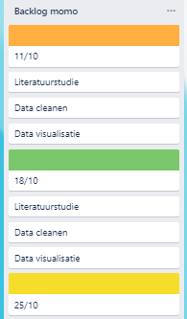
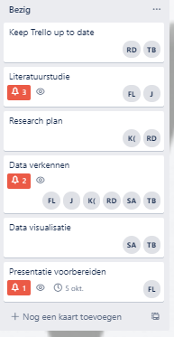
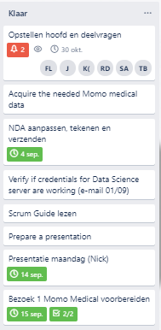
Planning and managing the project

Slide 10
What are we going to do?
* Continue the literature study
* Continue visualizing data
* Cleaning data

Slide 11
Questions?

